Slide 1
Reporting your way upwards
https://sites.google.com/view/athletictm2/british-athletics

Slide 2
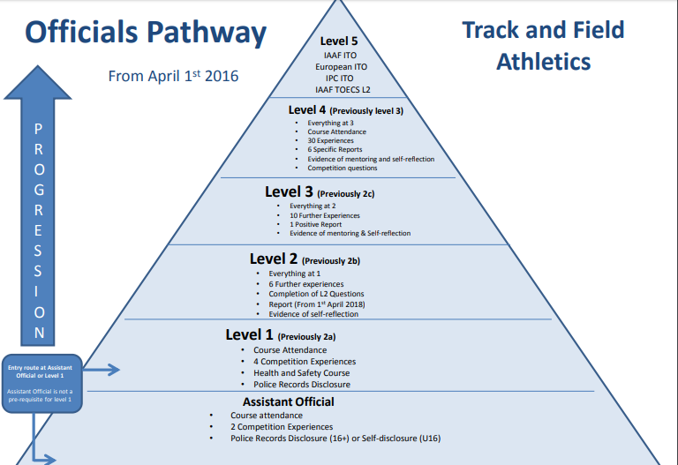

Slide 3
To go to Level 2: Have one positive report completed by an official in the same discipline who has been Level 3 or above for at least 2 years. For field judges this must include working on a long throw and showing understanding of the long throws protocol. Discipline specific report forms can be found on the UKA website or from just below.
To go to Level 3: Obtain at least one positive report from a higher graded (Preferably Level 4 National) official when officiating at Regional level or above. There is a discipline specific Level 3 report form which can be found on the UKA website. From April 1st 2019 for field judges this report must show that the candidate has a clear understanding of the long throws protocol. This is to be sent to the Tri Regional or National Officials Secretary (TRNG). The candidate should also keep a copy of all reports.
To go to Level 4: Obtain at least six positive reports from active Level 4 National officials when officiating as
Team member x3; EDM operator; field referee (include duty sheet); AOA report. These should be sent to the Tri Regional or National Officials Secretary (TRNG). The candidate should also keep a copy of all reports. You must submit all reports for your application.

Slide 4
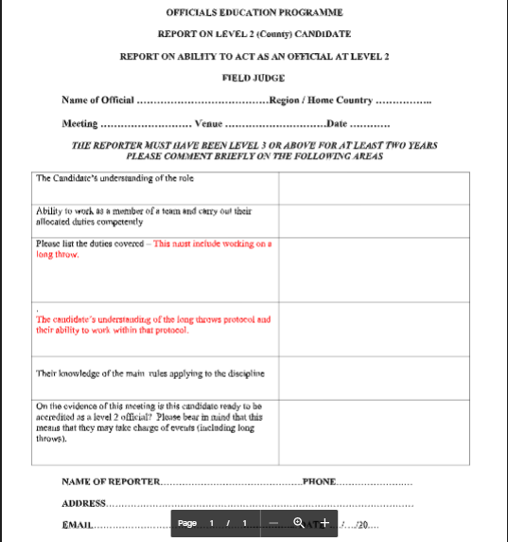
To goto Level 2
Team Member

Slide 5
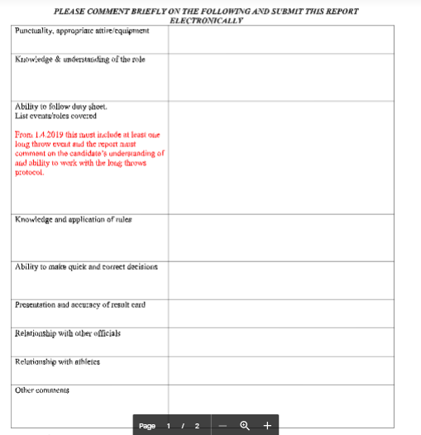
To goto Level 3
Team Member

Slide 6
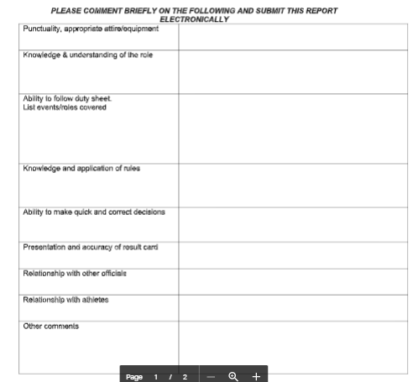

To goto Level 4
Team Member
(2= out of Area)

Slide 7
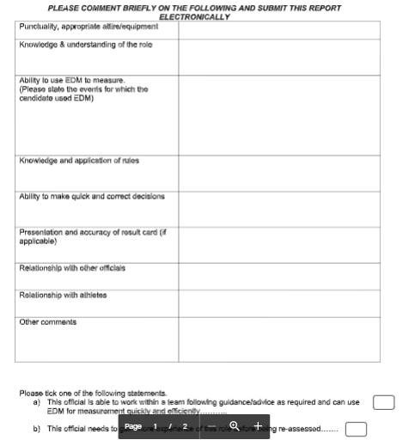
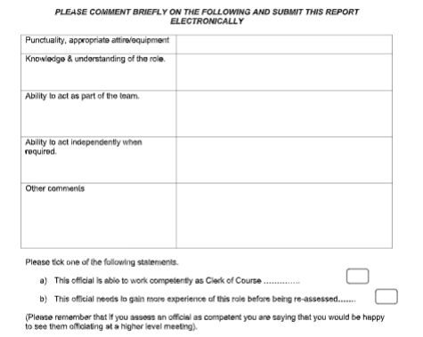
To goto Level 4
Clerk of Course
To goto Level 4
EDM

Slide 8

To goto Level 4
Chief (Field Referee)

Slide 9
How to get a report!
As much advanced notice as possible
Contact competition provider as request
Ask ELSE group
Contact field referee and ask
If travelling with a club ask host club in advance
Try not to line up friends to report on you, leave others to decide

Slide 10
Duties for a report
 |  |  | Reporter
Pole Vault |  | possible tasks | Chief Judge | Bar replace 1 | Bar replace 2 | Clock | Scoreboard | Athlete steward | Notes/ guidance
Candidate (Reportee) | Chief Judge | Lead event, check runway for marks, check measure, progressions, athlete briefing, upright position |  |  |  | x | x | x
 | Bar replace 1 | set bar, replace bar, position uprightscheck measure, plane of uprights, hands on pole, push back of poleflags | x |  | x | x | x
 | Bar replace 2 | set bar, replace bar, position upright, pole plant, check measure, validity of take off, supervise warm up | x | x |  | x | x
 | Clock | set clock, card 2, upright indicator | x |  |  |  | x
 | Scoreboard | scoreboard, card 3, cone | x |  |  | x
 | Athlete steward | supervise athletes, competition area, exit from comp area | x

Slide 11
Reporting during the day

Slide 12
The written report
Factual
Specific
Personal
Evidence based
Helpful

Slide 13
Record of Experience (what I Learned)
Men Discus - EDM Spike, sector judge. Men Hammer - Rear of circle, Time clock, Implement landing & exit circle, Gate change | wait until lead sits down before startin clock
U15B/U17W Hammer - Card 2, scoreboard.U17M LJ Card 2 , takeoff board, check measure, scoreboard. U17M Discus - EDM operator card 1. U15B Javelin - retrieve implements, sector judge, tidy site. | Check people are not doing the same thing all day
W Shot - arm action, pull through tape. M Javelin - Tape pull through. W High jump - Lead card 1, call up, height progression. Take over judge on relays | 4x100 take over is from gold line and 2nd yellow tick. 4x300m take over is between the 2 yellow ticks
.

Slide 14
I was down as Infield Spotter No such job - worked as Athletes Steward on Mens Triple Jump. Women Javelin. | saw coach pass HIS accreditation to some one in the crowd, asked him to get it back otherwise he would have to leave. Man passed it back and I check it was the correct one, told Field Ref what had occurred
Field judge: Shot, men: spike; shot, women: pull through and arm position/put validity; discus, women: pull through; discus, men: spike | To watch arm position/movement of shot away from neck before putting particularly carefully in athletes new to the event. The weather was terrible (heavy rain) meaning regular drying of the discus circle was needed between throws.
Field referee | To check with helpers before the meeting whether they will have to leave before the end of the meeting so substitute helpers can be put in place before the last minute. That having an inexperienced meeting manager means a lot more track-related and meeting-related questions for the field referee than would be anticipated if the meeting manager were more experienced.
Field judge: Long jump, women: card and board validity; long jump, men: spike and rake; triple jump, women: pull through and jump validity; triple jump, men: spike and rake | That the arrival of an air ambulance landing on the infield means a total pause to the meeting until after the air ambulance leaves; and that although the event will inevitably finish later than hoped and advertised, it is important to keep to the rules and standards of competition while being fair to all athletes taking part.

Slide 15
Not so helpful
U15G Long jump - Pull through tape, repair no jump indicator, supervise warm up at board. U20W Hammer - card 2, scoreboard, supervise warm up with horn. U15B Hammer Sector judge, retrieve implements, tidy site. U15G Javelin - Validity of landing. U15B Javelin - Leader, call up, tick card, horn, clock, arc, flags.U15G Triple Jump - EDM spike, pit judge, foot sequence.
Meeting Manager. Discus x 2 Lead, horn, front/rear of circle. Straight on to be Marksman, for Starter | Manic day, multi tasking
Long Jump Yr 3 - Pull through, take off board Long Jump Year 4 & 5 Boys - Rake pit, pit judge Long Jump Year 6 & 7 Boys - Spike, pit judge Turbo Javelin U11 - Retrieve implements | A really fun competition. Loved working with the younger athletes.
Shot - Men Leader, card, measure, front and rear of circle Shot - Women Sector judge, spike, zero end of tape | Completed the competitions quickly and efficiently. Always a nice bunch of people at this masters event.
Ensure High Jump is set up correctly and heights checked. Ensure equipment is at the competitiion area. Long Jump Girls Year 4 & 5 Pool 1 - Pull through, zero end of tape Long Jump Girls Year 6 & 7 - Rake Pit, Pit judge Long Jump Boys Year 6 & 7 - Call up, tick sheet, check numbers | Was Field Referee but a short of officials I had to help out where necessary. Having discussed this scenario with mentor I carried out duties which would not affect the outcome of a throw or jump

Slide 16
Record of experience (mentoring)
Conference SEAOA | Track And Field | Meeting/facilities assessments etc. | Others | AGM Colindale | Conference |  | Anne Usher gave an enthralling, motivational presentation.
Mentoring | T&F | Referee role |  |  | Explored role of referee, tasks ahead of day, paper work, tasks on the day and post the day | Useful Gant chart in excel for timetable and tracking duties, excel for duty sheet. Need to put into practice next season

Slide 17
South of England Athletics Officials Association (SEAOA) AGM & Conference. | L/O | Shenfield | Regional Conference | 1. Technical Manager/Clerk of Course/Referee today. 2. Hammer. 3. Communications at a Meeting.
Southern Combined Events Championships (All Age Groups) | C 1 | Lee Valley | Long Jump Pull through tape, repair indicator board. Long Jump Pit Judge, level sand. Shot Put Spike. High Jump Leader, Card 1, call-up. | Finding the exact spot to mark the landing of the indoor Shot Put can be challenging unless a large amount of chalk is applied to the shot by the athlete. I noted that the UKA safety advice is to remain outside the landing sector, even indoors, but most judges seem to stand inside the sector towards the rear. When I was leading the High Jump there were no other track or field events in the stadium and it was so quiet that only my voice could be heard, an amazing experience!
London Indoor Games (LIG) Under 17s | C 2 | Lee Valley | Shot Put Leader, Card 1, call-up, front & rear of circle, flags, measure & announce distance. Shot Put Retrieve implements. Long Jump Supervise warm-up, call-up, time, runway control. Triple Jump Leader, Card 1, board, change board, flags, measure & announce distance. Pole Vault Scoreboard, Card 2, pole plant, hands on pole. | I only turned the scoreboard around to where there were people, but some judges thought it should be rotated 360°. This seemed pointless since there was nobody behind me.
Southern U13/15/17 | C 3 | Lee Valley | Clerk of Course and Mentoring Programme | I learnt a lot not only from doing the job, but also from being with Steve all day. I was shown some quick ways of working, eg setting up High Jump. I took the opportunity to ask about a lot of things, so it was a good learning opportunity. I also prepared to put out the prisms at the break points, but in the end the track staff did this. I think that today was good preparation for when I will be Technical Manager at the Surrey/Sussex Indoors.

Slide 18
Assessment

Slide 19
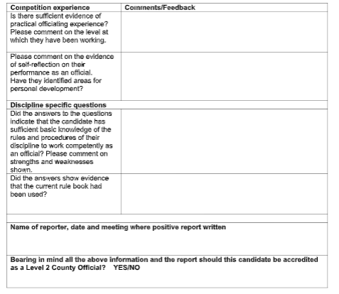

Slide 21
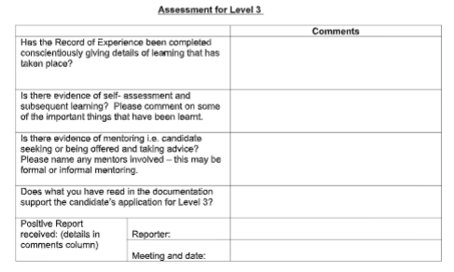

Slide 23
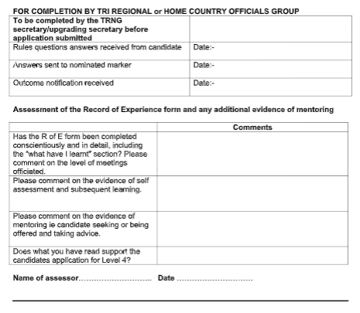

Slide 25

https://sites.google.com/view/athletictm2/british-athletics

Slide 26
