Slide 1
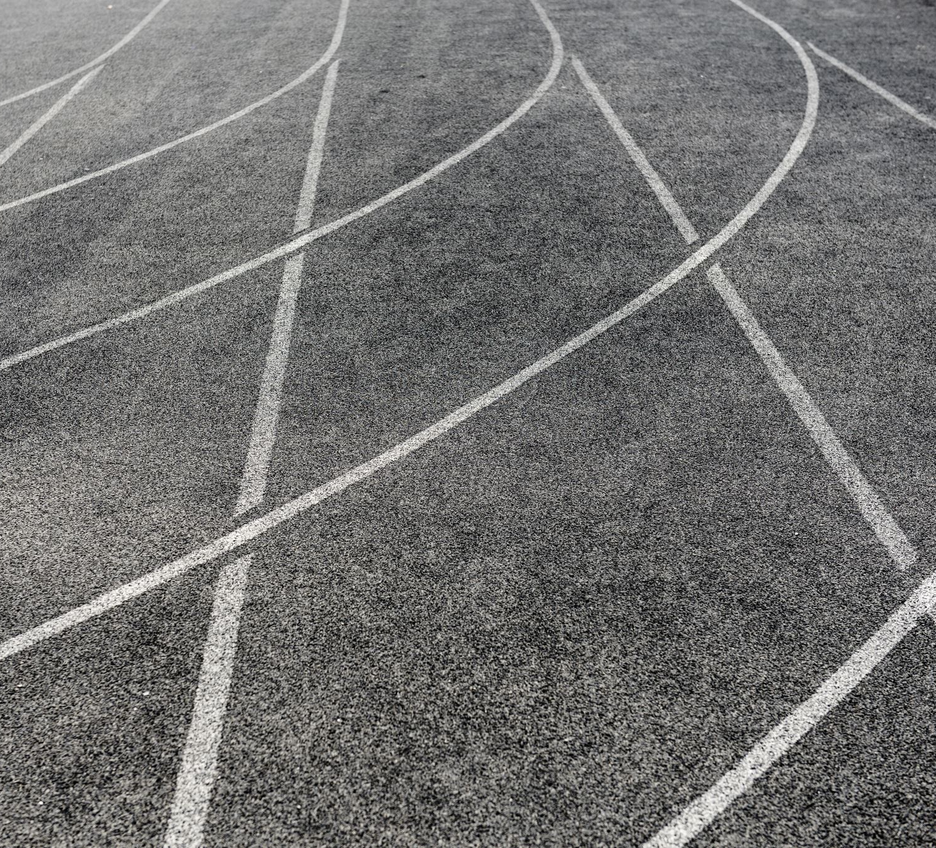
The Inside Track
Working with both Main and infield PF Cameras
November 2019

Slide 2
The Inside Track - Working with Multiple PF Cameras
Why use more than one PF camera?
Setup and alignment
Why this is important to picture interpretation and Reading
How to Read pictures

Slide 3
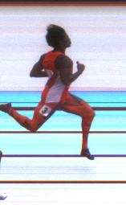
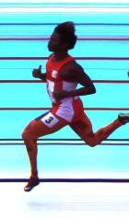
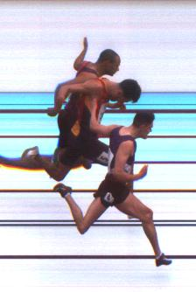
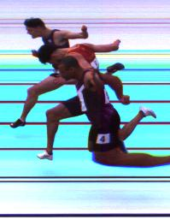
Why Use More Than One Camera?
Obscured Torso

Slide 4
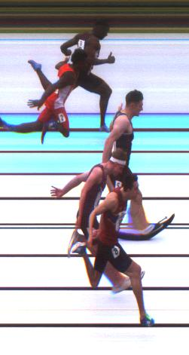
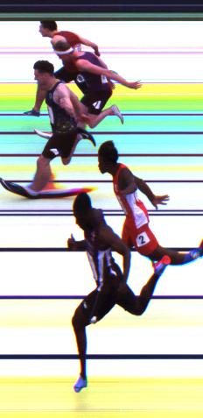
Why Use More Than One Camera?
Close Results

Slide 5
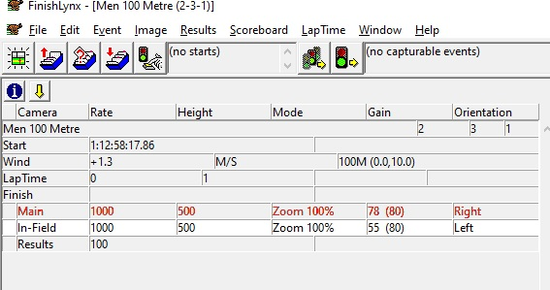
Why Use More Than One Camera?
Resilience

Slide 6
Two Possible Configurations
Main and Infield cameras on same system
  One start system
  Both Main and Infield pictures available on same Read PC.
  Time tracking between cameras
Main and Infield cameras on separate systems
  Multiple start systems – must be time synchronised
  Main and Infield pictures available on different PCs
  No inter-system tracking

Slide 7
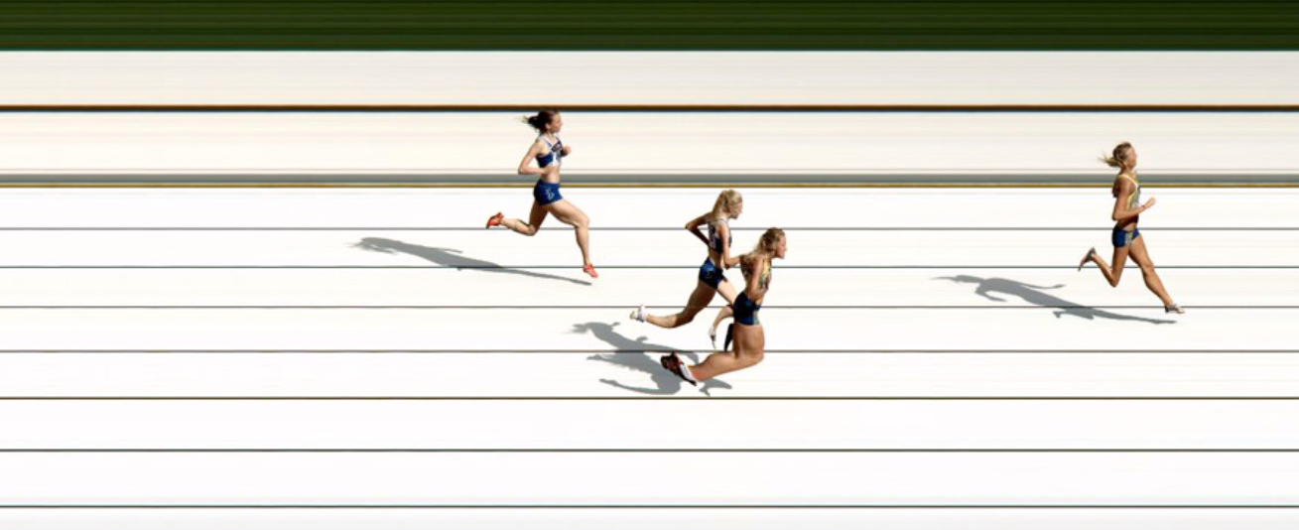
Camera Setup and Alignment
Is this camera aligned correctly with the finish line?

Slide 8
Camera Setup and Alignment
Tilt
Pan
Swivel

Slide 9
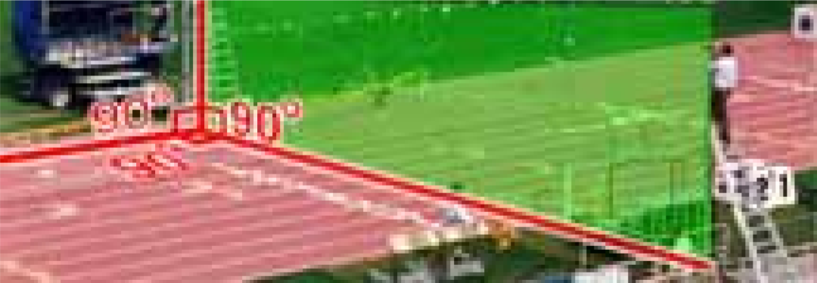
Camera Setup and Alignment
Camera(s) must be aligned in all 3 dimensions
  Not just the one you can see on the PF picture

Slide 10
Camera Setup and Alignment
Is this camera aligned correctly with the finish line?

Slide 11
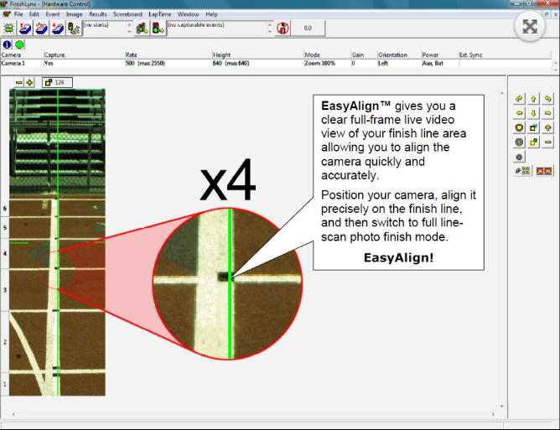
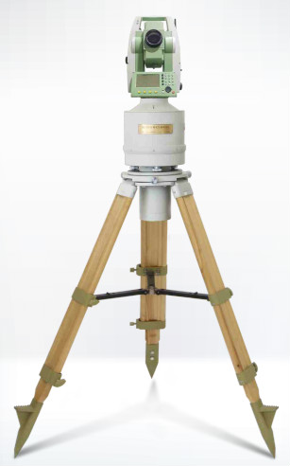
Camera Setup and Alignment

Slide 12
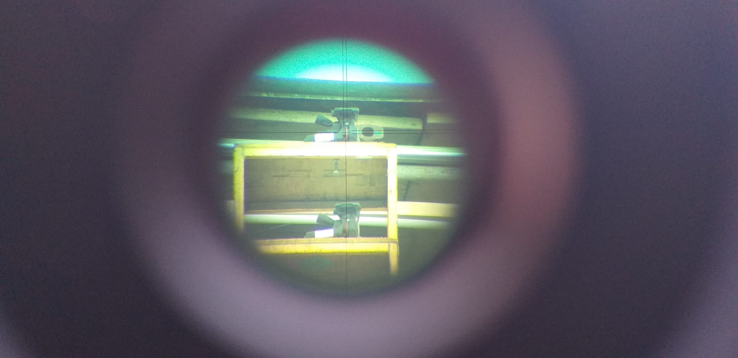
Setup with Two Cameras

Slide 13
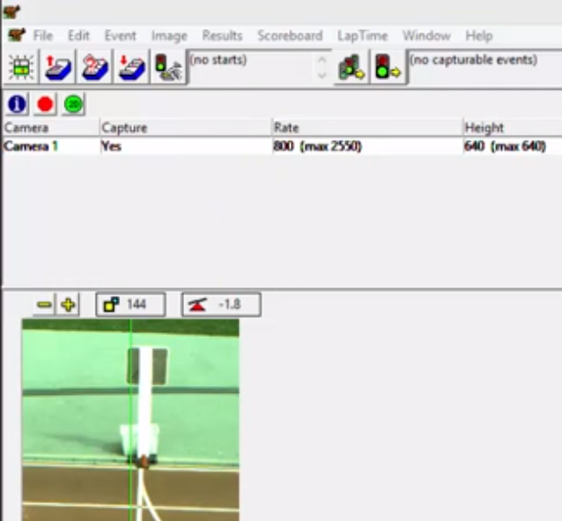
Beware Camera Level Indicator!

Slide 14
Tips for Ensuring Correct Camera Alignment
Give yourself plenty of time – you will need several hours to get this right!
Get help – it’s a two or three person job
Use spirit level to ensure camera(s) are level
Minimise size of black lane markers
Minimise width of white board on inside/outside of track

Slide 15
Testing and Verifying Alignment of Cameras
Run Throughs
Used to validate that Main and Infield cameras are aligned with each other in all 3 dimensions
Involves capturing test athletes on both cameras through finish and checking reference points
  Both outside lanes and one middle lane are verified
  3 points are checked on each athlete – top of head, middle/torso, foot
Results will prompt camera adjustments
Results will influence how pictures are used and interpreted during competition

Slide 16
Run Throughs
DEMO 1

Slide 17
Run Throughs – Recording Sheet

Slide 18
Run Throughs
DEMO 2

Slide 19
Run Throughs – Scenario 1
What’s the issue here?
What adjustments would you make?

Slide 20
Run Throughs – Scenario 2
What’s the issue here?
What adjustments would you make?

Slide 21
As a Reader, Why Do I Need To Know This?
Results of Run Throughs provide information on how pictures from both cameras should be used and interpreted
  Can you rely on times from your infield camera?
  Can athletes in all lanes be treated the same?
  If not, how should you adjust how you read?
    Use reference points
    Use time offsets

Slide 22
Reading Pictures
What?
How?
Obscured Torso
Close Finish
Direct from InField camera
Using reference points
Using time offsets
DEMOs

